Slide 1

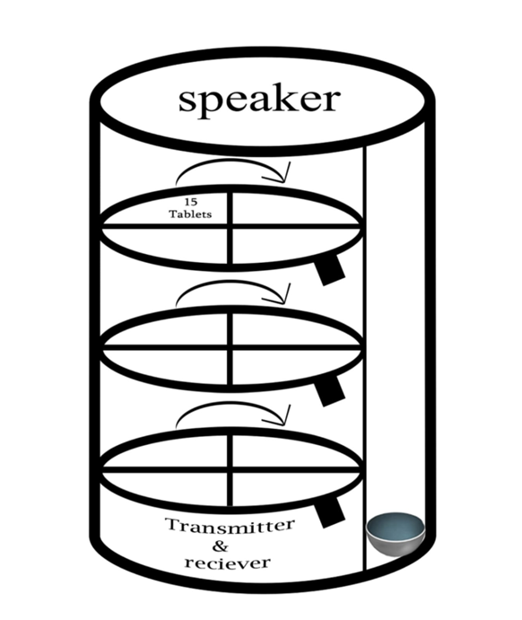
Automatic pill dispenser
Presented by
D.R NANDA GOPAL
B.Tech Information Technology

Slide 2
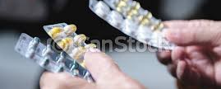
Problem Statement
Elderly forgetting medication

Slide 3
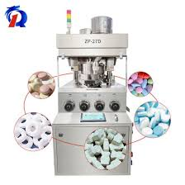
Solution
The particular pill falls into the collector at the proper time The pill wheel rotates until the correct pill reaches the opening valve or until the correct compartment is in the right place for you to drop the pills. The user can fill the compartments manually . You can take the pill wheel out of the device, and place the pills into designated compartments.

Slide 4
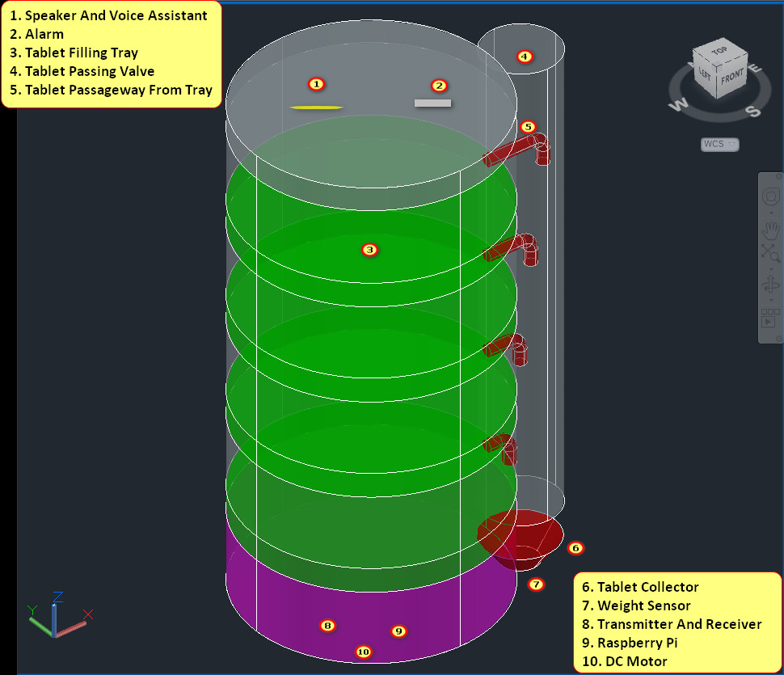


Slide 5
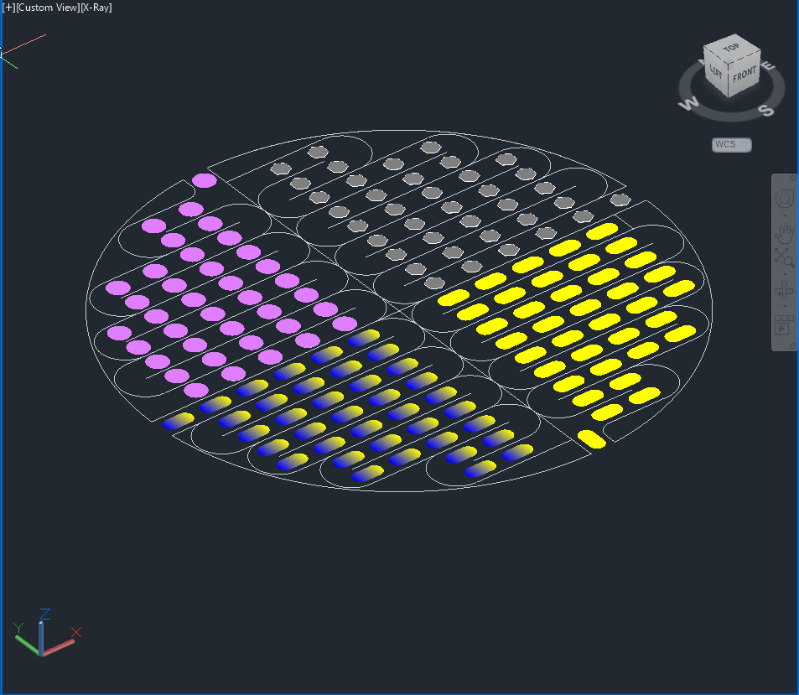
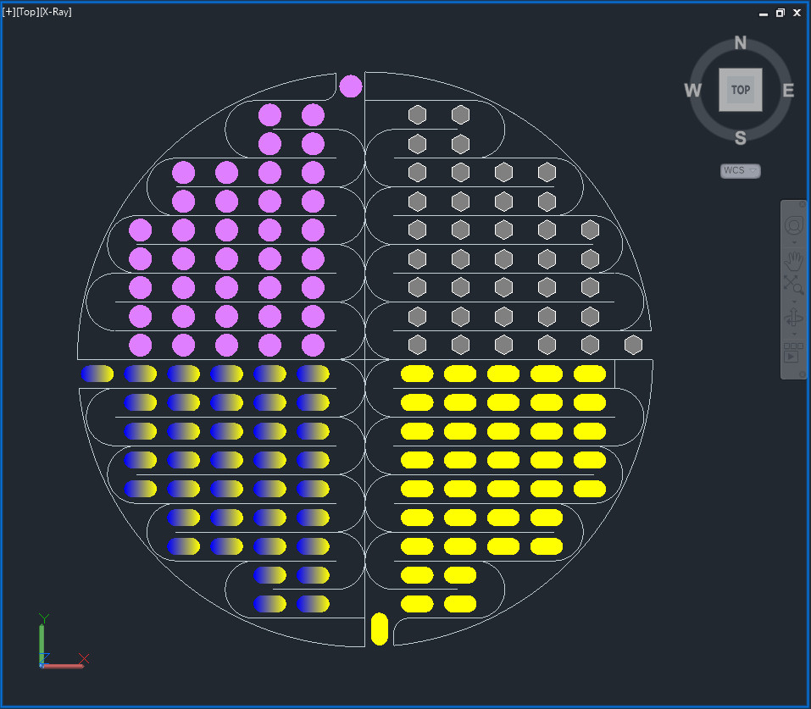

Slide 6

UNIQUENESS
This device is cheaper than other device and mechanism is simple and accurate
so it is very useful for middle class people especially for Indians
it is useful for the aged people to easy to take the medicine
by taking the pills in correct time it reduces the health issues of people

Slide 7


LCD display
DC power source (19.5V)
PC (Input)
Arduino
IR Circuit
Raspberry pi
MATERIALS
USED

Slide 8

Conclusion
This Device Is Cheaper Than Other Device
So It Is Very Useful For Middle Class People Especially For Indians
It Is Useful For The Aged People To Easy To Take The Medicine
By Taking The Pills In Correct Time Its Reduced The Health Issues Of People this Device Is Cheaper Than Other Device
So It Is Very Useful For Middle Class People Especially For Indians
It Is Useful For The Aged People To Easy To Take The Medicine
By Taking The Pills In Correct Time Its Reduced The Health Issues Of People

Slide 9
Thank you

